Slide 1
Embryology:
Central Nervous System

Slide 2
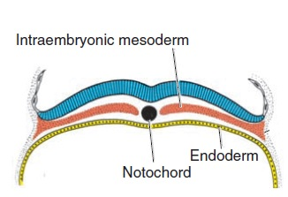
A. Dorsal view of a late presomite embryo at approximately 18 days. The amnion has been removed, and the neural plate is clearly visible. B. Dorsal view at approximately 20 days. Note the somites and the neural groove and neural folds.

Slide 3
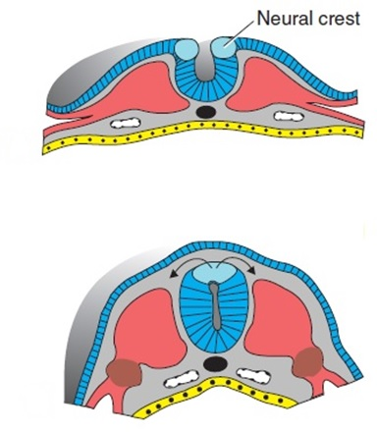
A
B

Slide 4
A. Dorsal view of a human embryo at approximately day 22. Seven distinct somites are visible on each side of the neural tube. B. Dorsal view of a human embryo at approximately day 23. The nervous system is in connection with the amniotic cavity through the cranial and caudal neuropores.

Slide 5
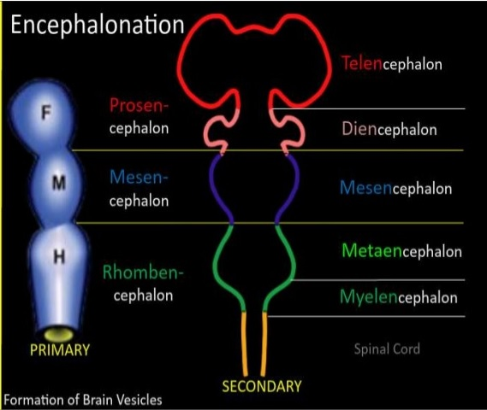
Basic anatomy of the three-part (A) and five-part (B) human brain.

Slide 6
Spinal Cord
Left, Cross section through the early neural tube. Right, Higher magnification of a segment of the wall of the neural tube

Slide 7
Spinal Cord
A, B. Two successive stages in the development of the spinal cord. Note formation of ventral motor and dorsal sensory horns and the intermediate column.

Slide 8
Development of a neuroblast
Various stages of development of a neuroblast. A neuron is a structural and functional unit consisting of the cell body and all its processes.

Slide 9
Origin of the nerve cell and the various types of glial cells. Neuroblasts, fibrillar and protoplasmic astrocytes, and ependymal cells originate from neuroepithelial cells. Microglia develop from mesenchyme cells of blood vessels as the CNS becomes vascularized.

Slide 10
Positional Changes of the Cord
Terminal end of the spinal cord in relation to that of the vertebral column at various stages of development. A. Approximately the third month. B. End of the fifth month. C. Newborn

Slide 11
Neural Tube Defects
Varieties of closure defects of the spinal cord and vertebral column. A, Rachischisis. B, Spina bifida occulta, with hair growth over the defect. C, Meningocele. D, Myelomeningocele.

Slide 13
Brain
Lateral view of the brain vesicles in an 8-week embryo (crown-rump length ~27 mm). The roof plate of the rhombencephalon has been removed to show the intraventricular portion of the rhombic lip. Note the origin of the cranial nerves.

Slide 14
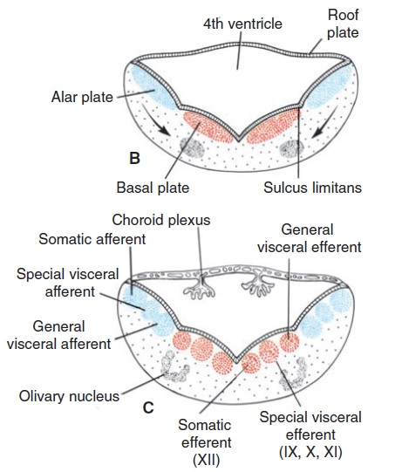
Myelencephalon
B,C. Position and differentiation of the basal and alar plates of the myelencephalon at different stages of development. Note formation of the nuclear groups in the basal and alar plates. Arrows, path followed by cells of the alar plate to the olivary nuclear complex. The choroid plexus produces cerebrospinal fluid.

Slide 15
Section of myelencephalon (medulla). Basal and alar lamina of myelencephalon. Roof plate connects alar laminae and forms the roof of the 4th ventricle. Cells of the alar laminae migrate in marginal zone that later forms olivary group of nuclei.

Slide 17
Metencephalon
Cross section through the developing metencephalon. Motor tracts are shown in green; sensory tracts are orange.

Slide 18
Cerebellum
A. Dorsal view of the mesencephalon and rhombencephalon in an 8-week embryo. The roof of the fourth ventricle has been removed, allowing a view of its floor. B. Similar view in a 4-month embryo. Note the choroidal fissure and the lateral and medial apertures in the roof of the fourth ventricle.

Slide 19
Mesencephalon
A,B. Position and differentiation of the basal and alar plates in the mesencephalon at various stages of development. Arrows in A indicate the path followed by cells of the alar plate to form the nucleus ruber and substantia nigra. Note the various motor nuclei in the basal plate.

Slide 20
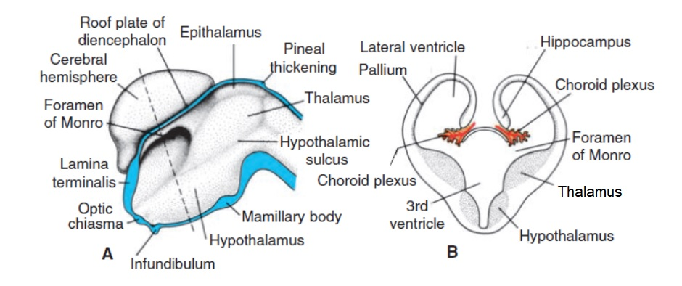
Prosencephalon
Diencephalon
Early formation of the cerebral hemispheres. A, Sagittal section through the brain. B, Cross section through the level indicated by the red line in A.

Slide 21
Telencephalon
A. Medial surface of the right half of the telencephalon and diencephalon in an 8-week embryo. B,C. Transverse sections through the right half of the telencephalon and diencephalon at the level of the broken lines in A.

Slide 22
A. Medial surface of the right half of the telencephalon and diencephalon in a 10-week embryo. B. Transverse section through the hemisphere and diencephalon at the level of the broken line in A.

Slide 23
Lateral views of the developing brain.

Slide 24
Increasing levels of complexity of the developing human brain

Slide 25
سلول های بافت عصبی
Neurons
Glial cells
سلول های گلیال از نورون ها حمایت کرده و در تغذیه آن ها نقش دارند.

Slide 26
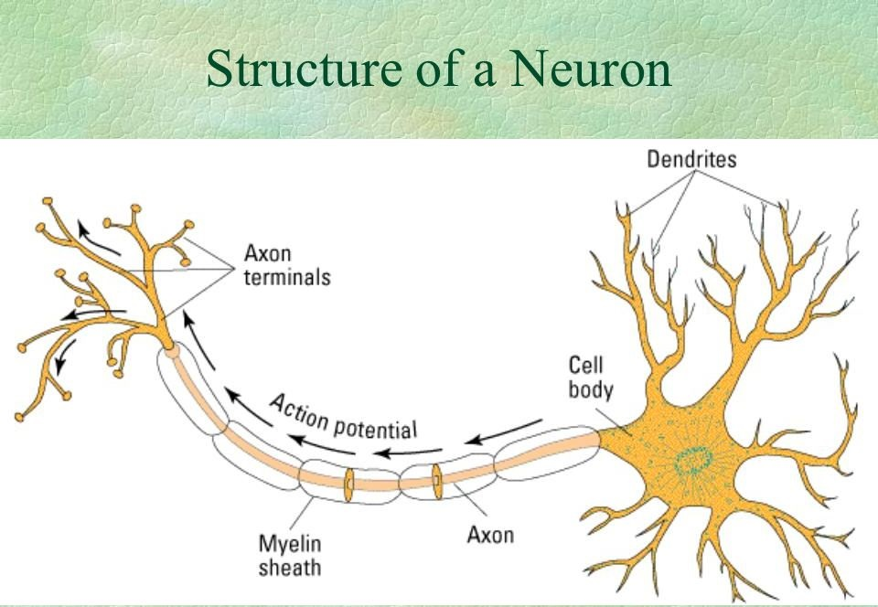

Slide 27
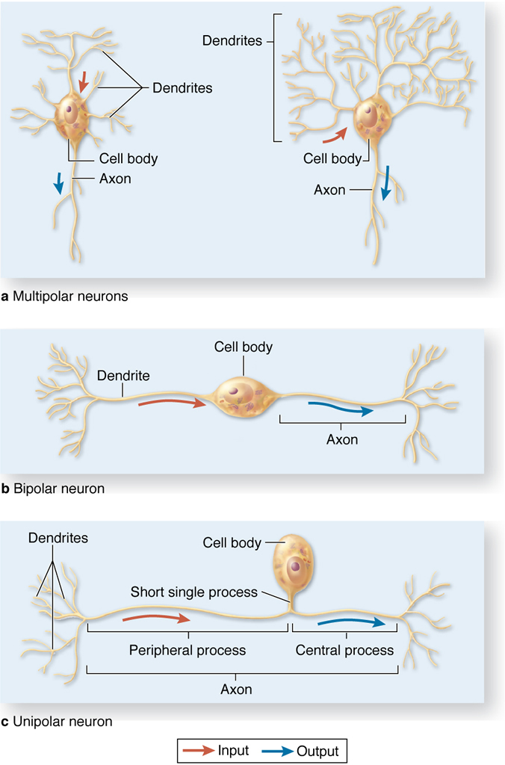
انواع نورون از نظر عملکرد و شکل ظاهری
نورون های حسی
نورون حرکتی
نورون واسطه
ــــــــــــــــــــــــــــــــــــــــــــــــــــــــــــــ
نورون های چند قطبی
نورون های دو قطبی
نورون های یک قطبی کاذب

Slide 28
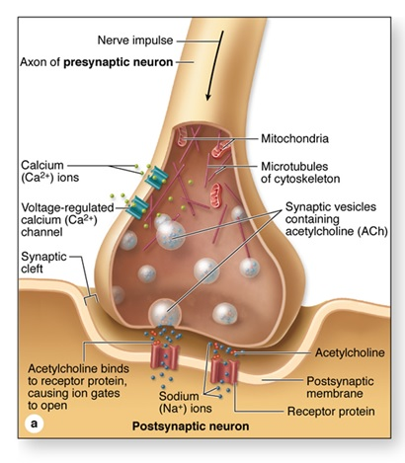
سیناپس
الکتریکی
شیمیایی

Slide 29
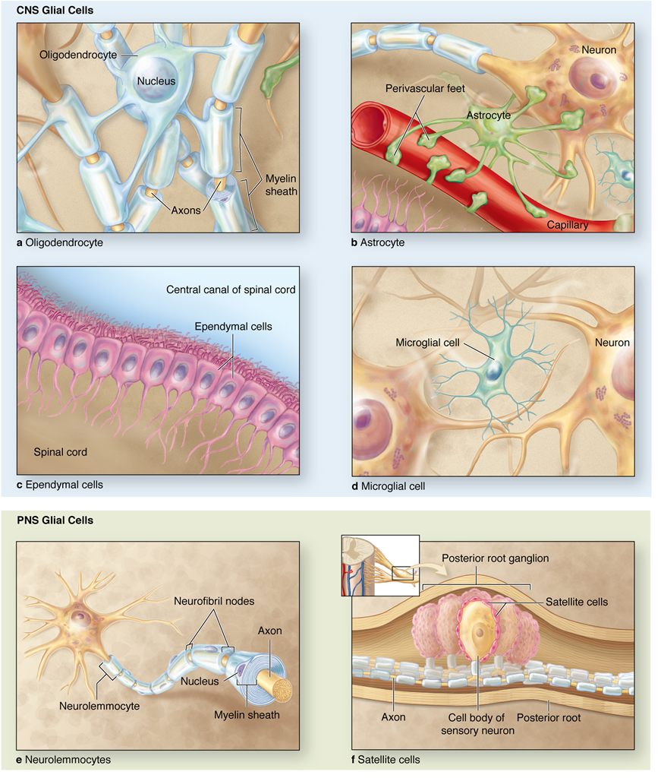
انواع سلول های گلیال
الیگودندروسیت ها
آستروسیت ها
میکروگلی
سلول های اپاندیم
سلول های شوان
سلول های اقماری

Slide 30


