Slide 1
Fronto-Amygdala Network as a Biomarker for Mood/Anxiety Disorders
NBML Webinar, 18 Feb 2017
Hamed Ekhtiari

Slide 2
Fronto Amygdala Connectivity

Slide 3
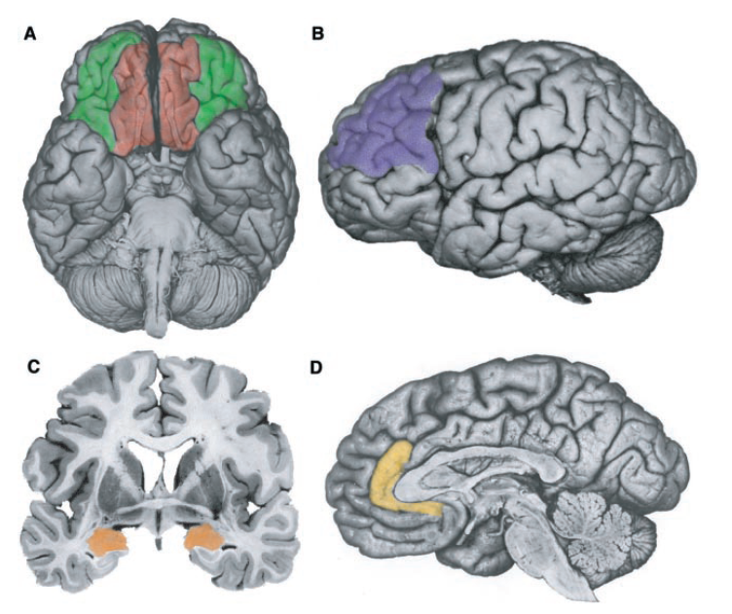
Our Main Regions of Interest in fMRI Studies of Mood/Anxiety Disorders

Slide 4
What about Amygdala?
Ball, et al. 2007

Slide 5
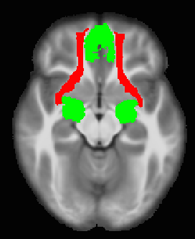
From Functional to Structural Connectivity
Deterministic Tractography based on 10 HC subjects
Seeds:
Left/right amygdala
Frontal medial cortex
Tracking parameters:
Angular Threshold = 60
Min length = 20 mm
Max length = 100 mm
FA > 0.2

Slide 6
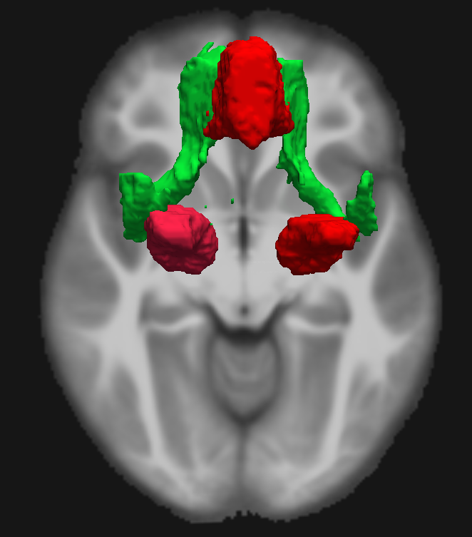
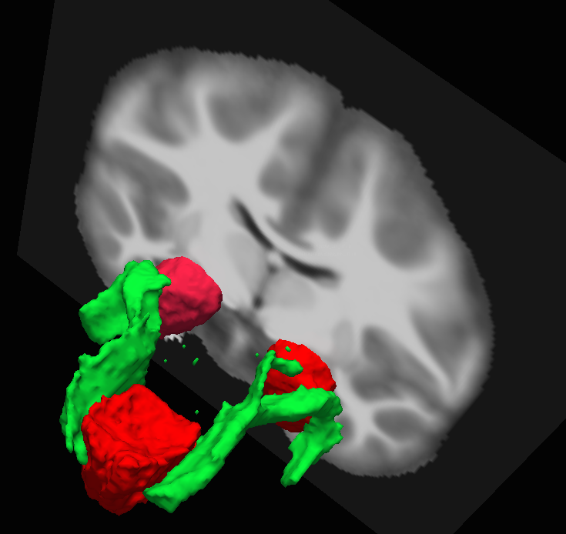
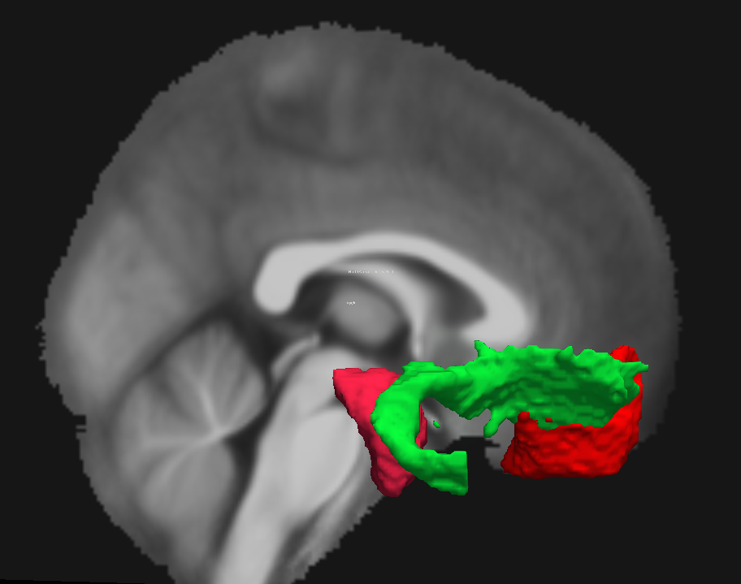
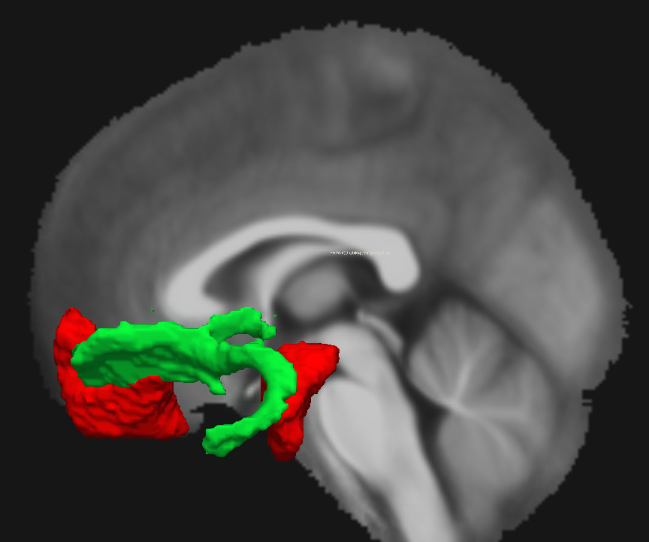

Slide 7
How do we measure functional connectivity between Amygdala and PFC?

Slide 8
Fronto Amygdala Connectivity

Slide 9
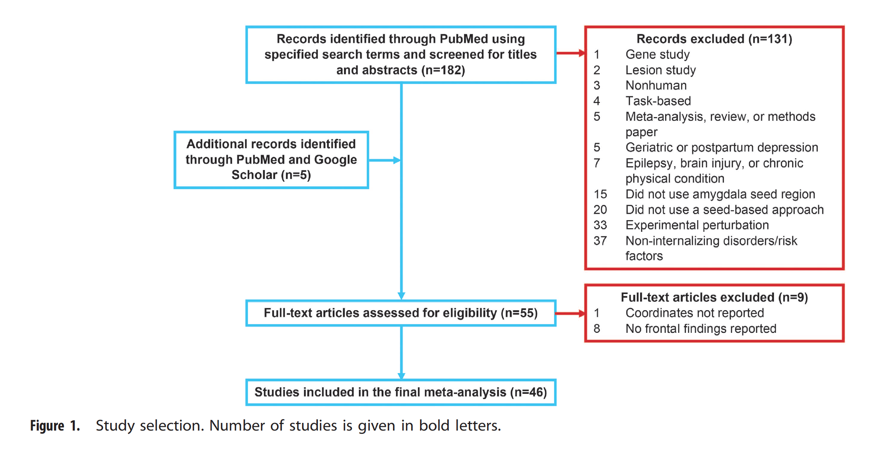

Slide 10
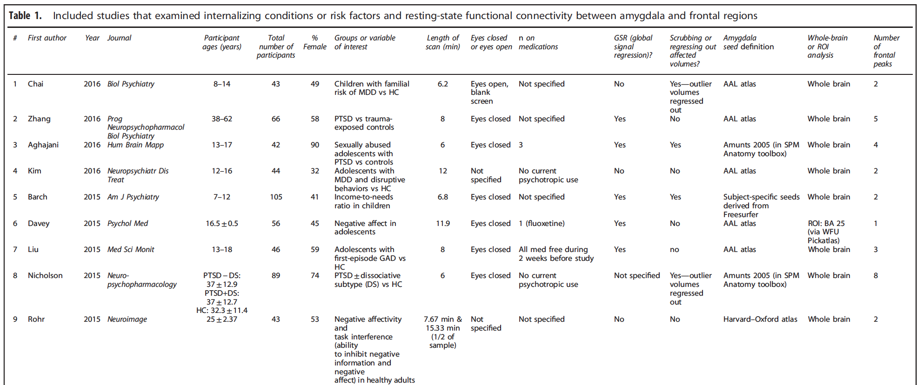

Slide 11
Activation Likelihood Estimation (ALE)
https://www.brainmap.org/meta/stats.html
http://www.brainmap.org/ale/

Slide 12
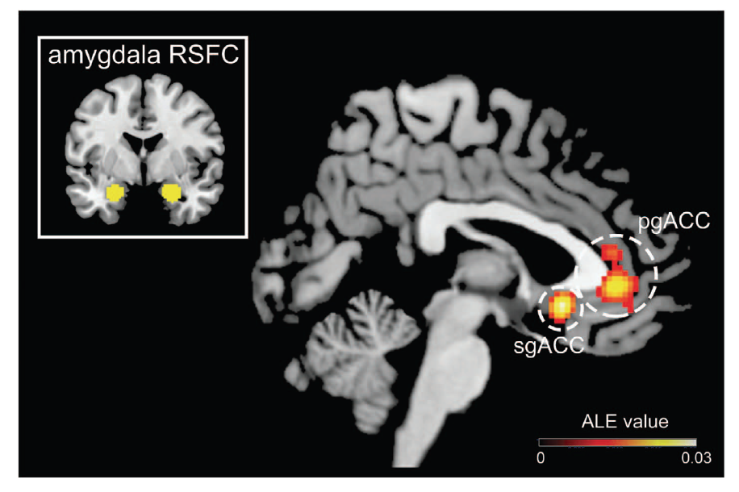

Slide 13
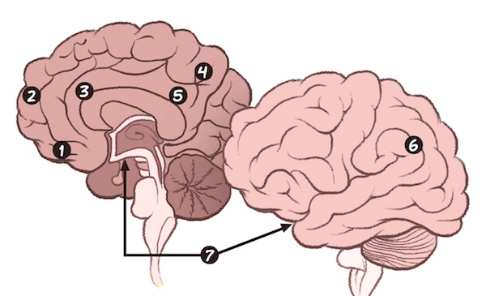
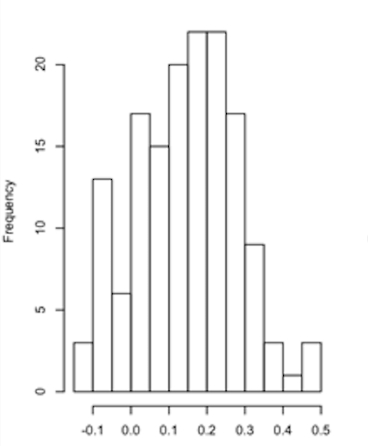
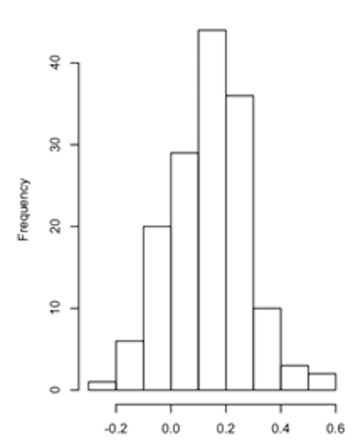
Fronto Amygdala Connectivity
Amygdala

Slide 14
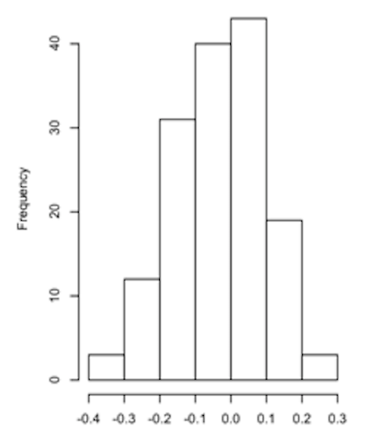
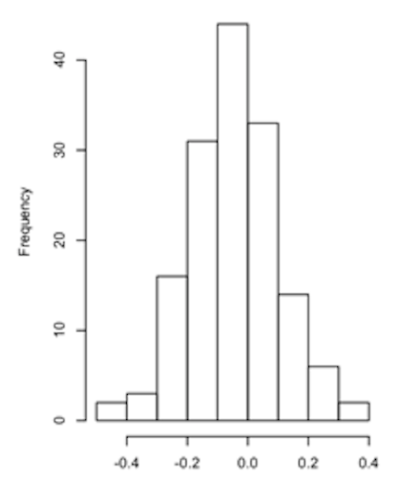
Fronto Amygdala Connectivity
Amygdala

Slide 15
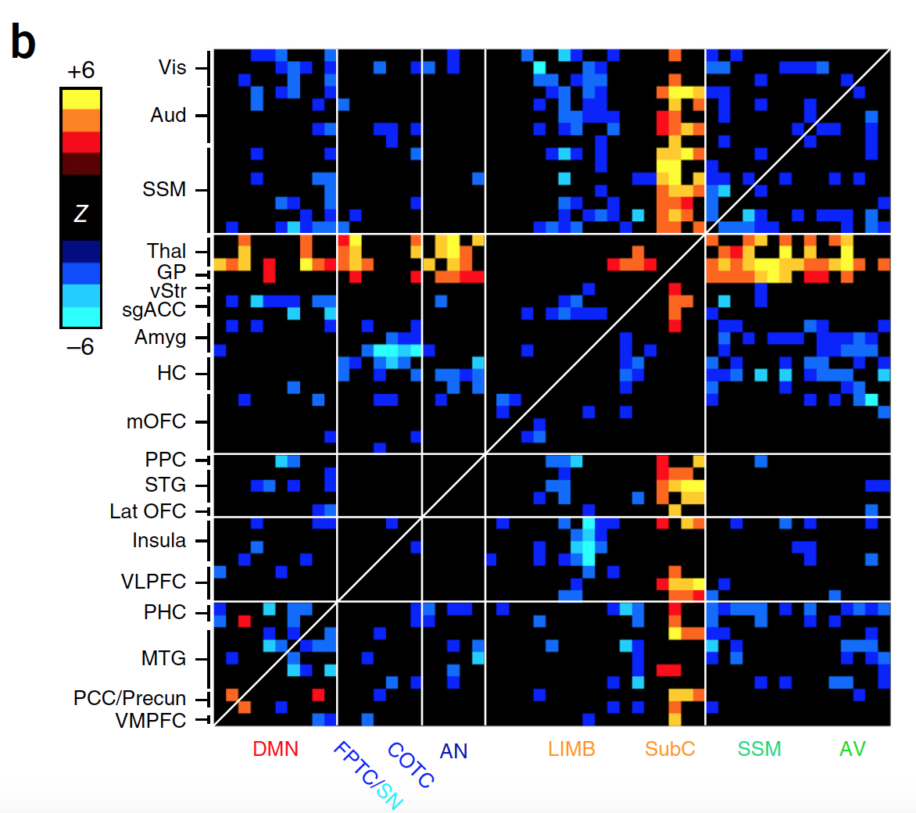
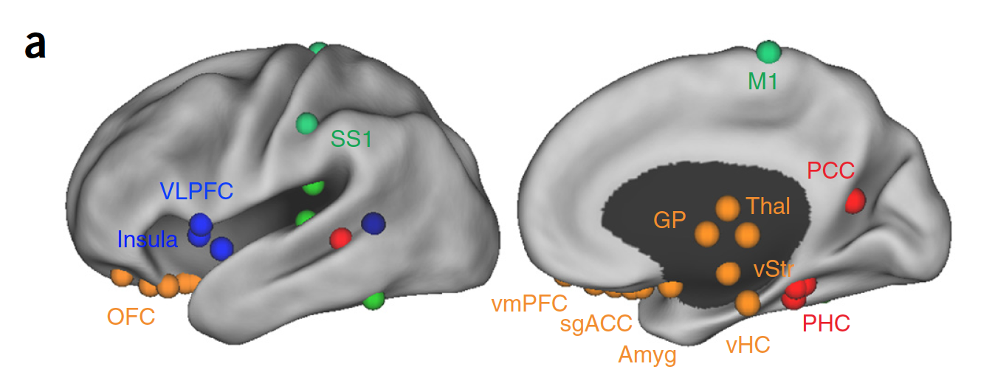
MDDs (220) vs. HCs (378)
Notes:
(25 ROIs (top 10%) with the higher difference using Wilcoxon rank-sum tests)
b. Top 50 most abnormal ROIs (Colored on the basis of Wilcoxon rank–sum tests comparing patients and controls)(Warm colors represent increase and cool colors decrease in depression as compared to controls.)

Slide 16
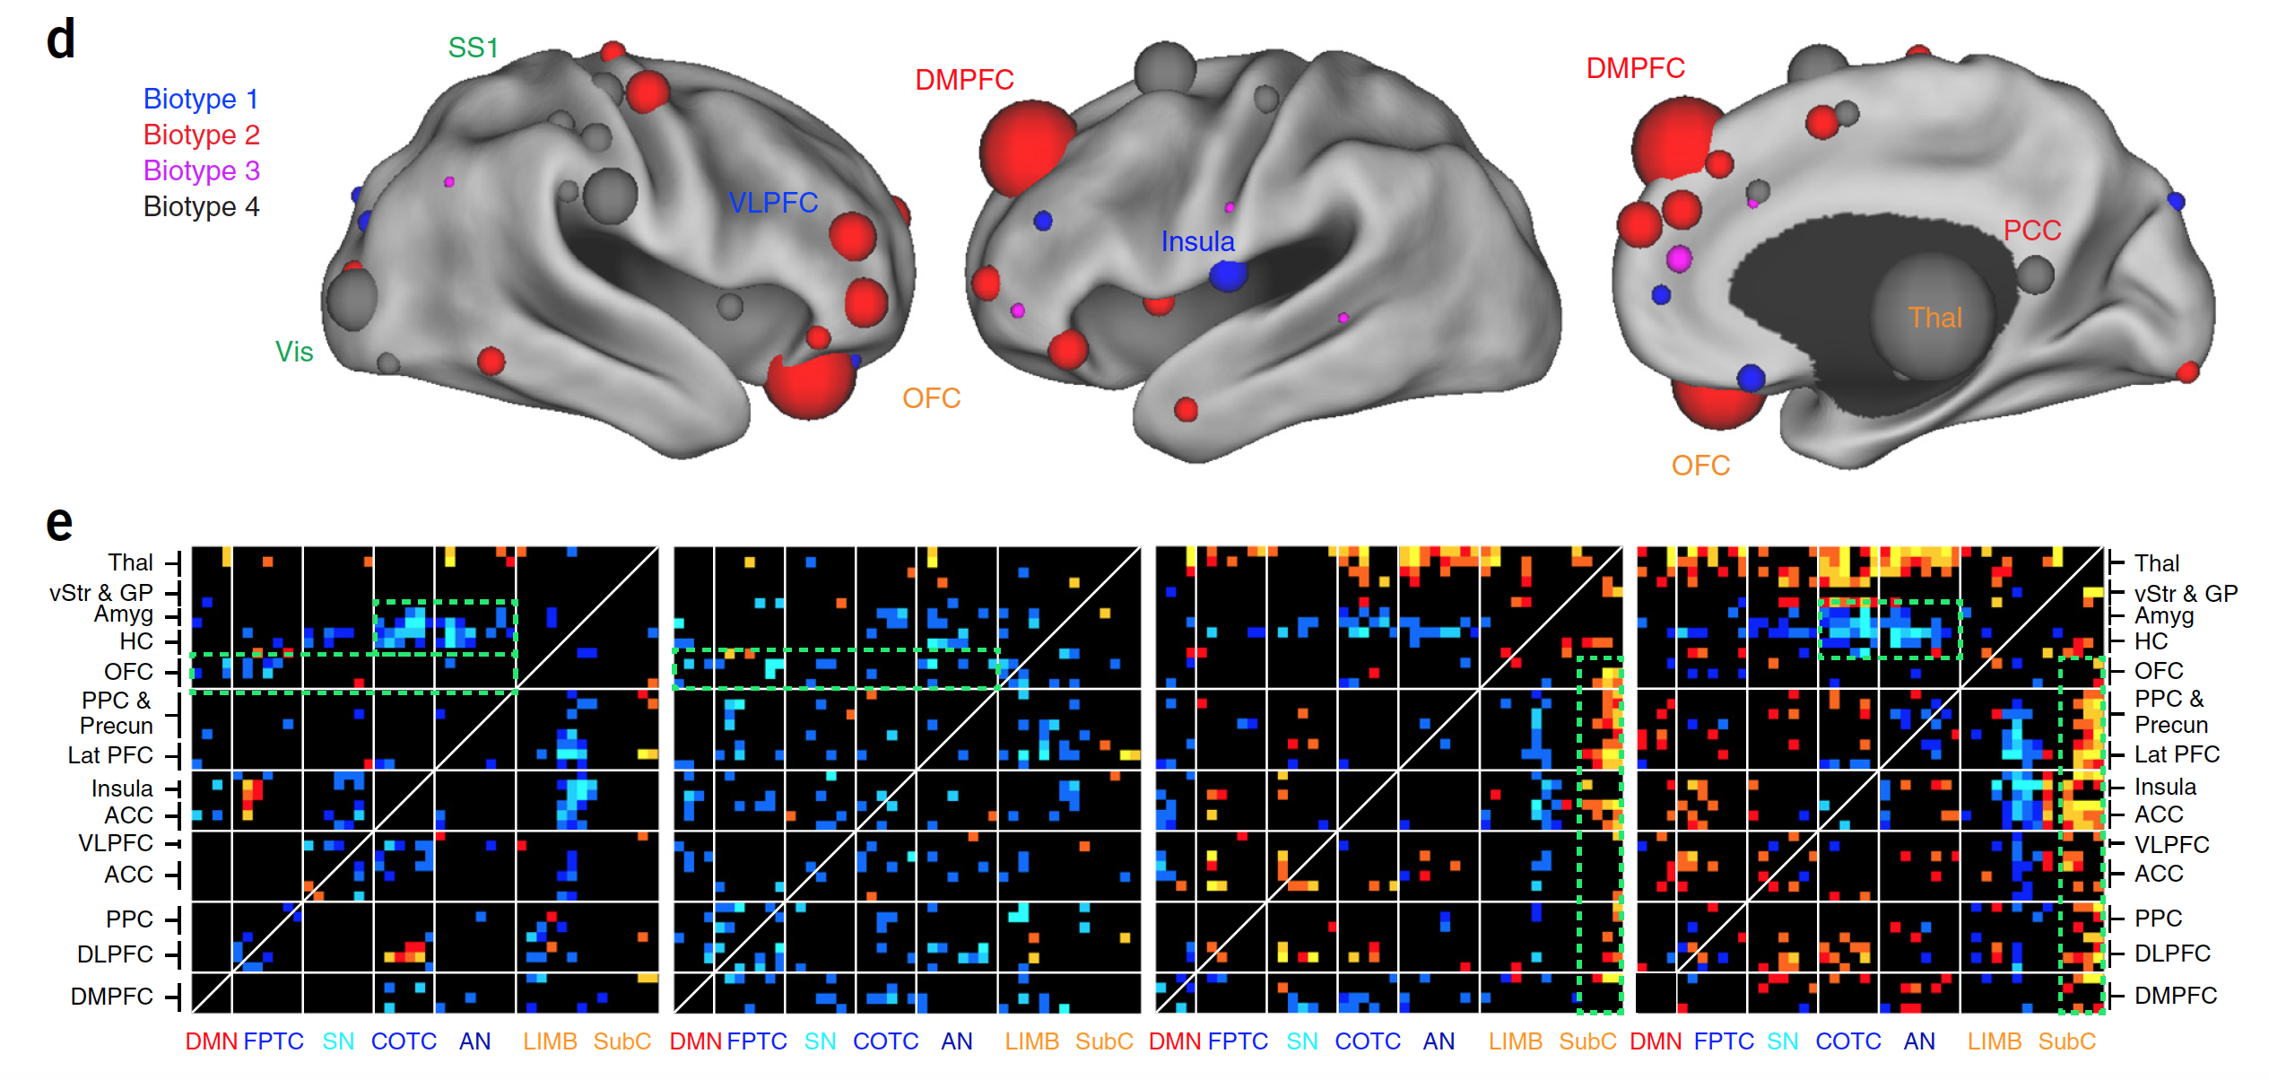
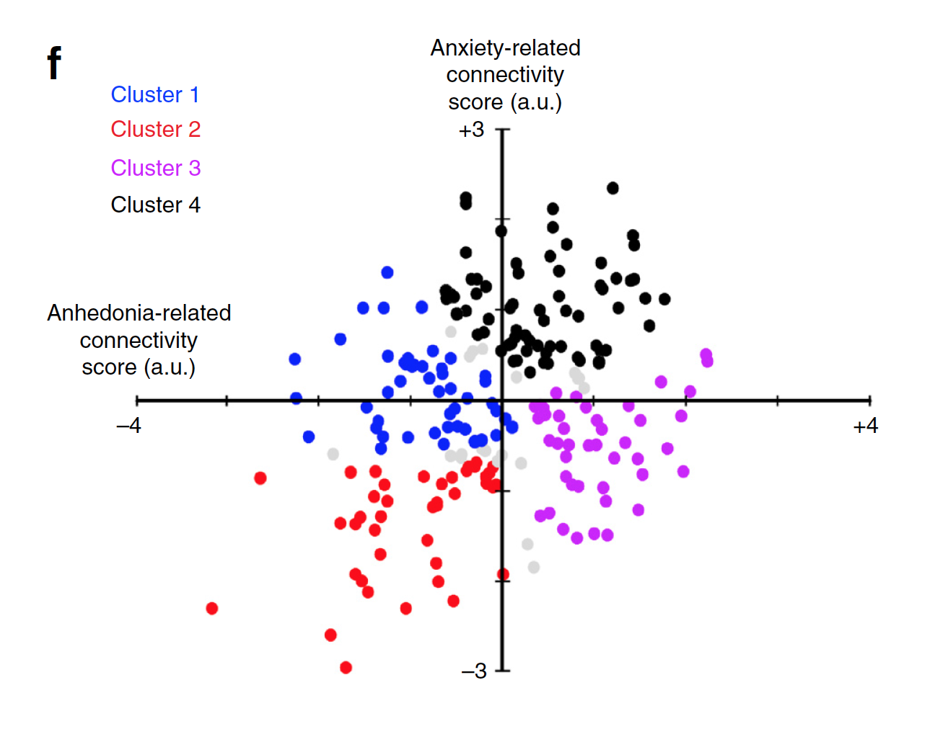
Neuroanatomical distribution of features that differed by biotype

Slide 17
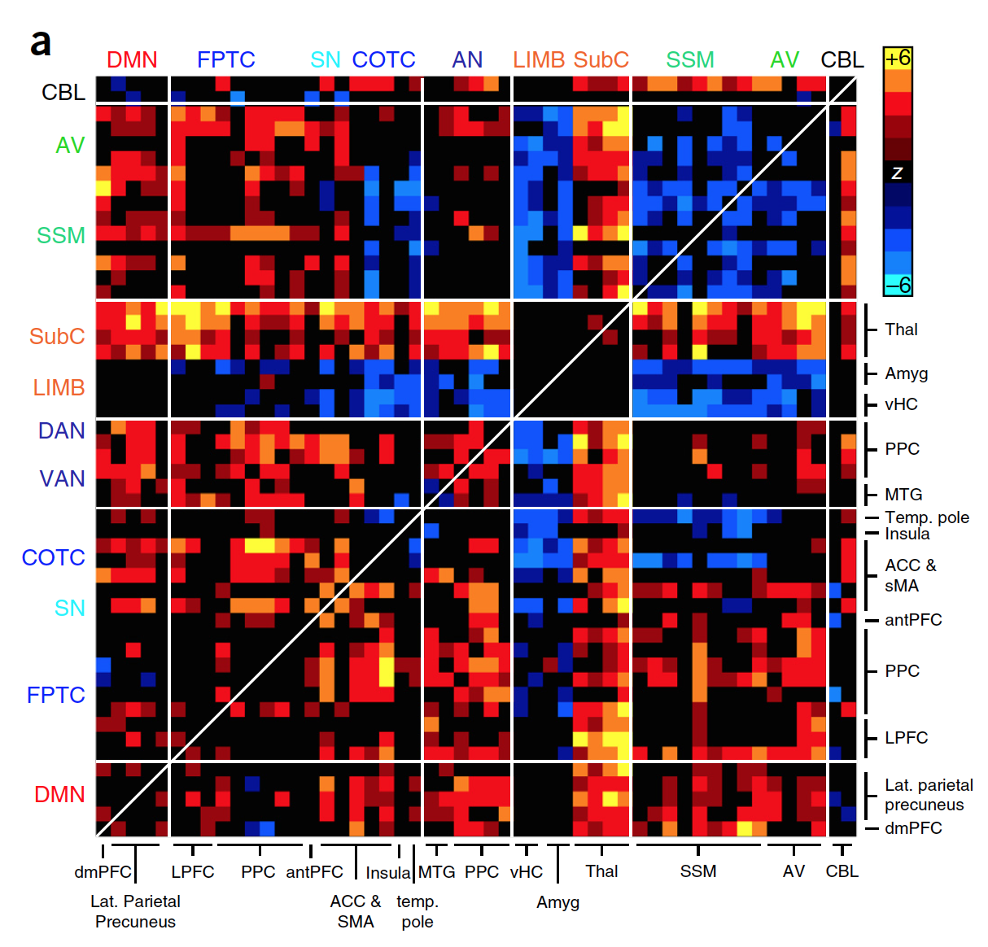
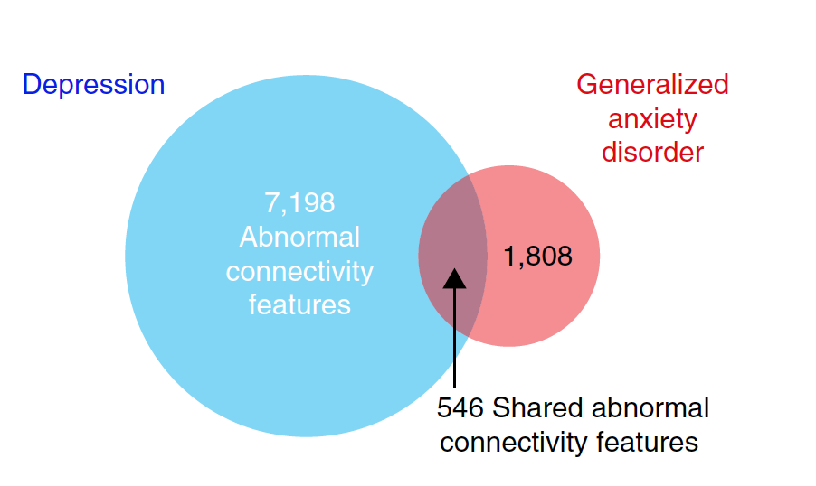
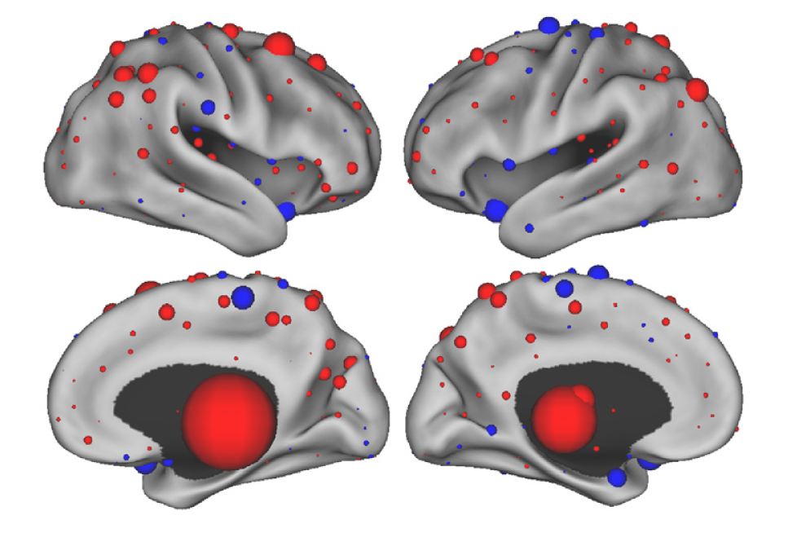
GAD (39) vs. HC (378)

Slide 18
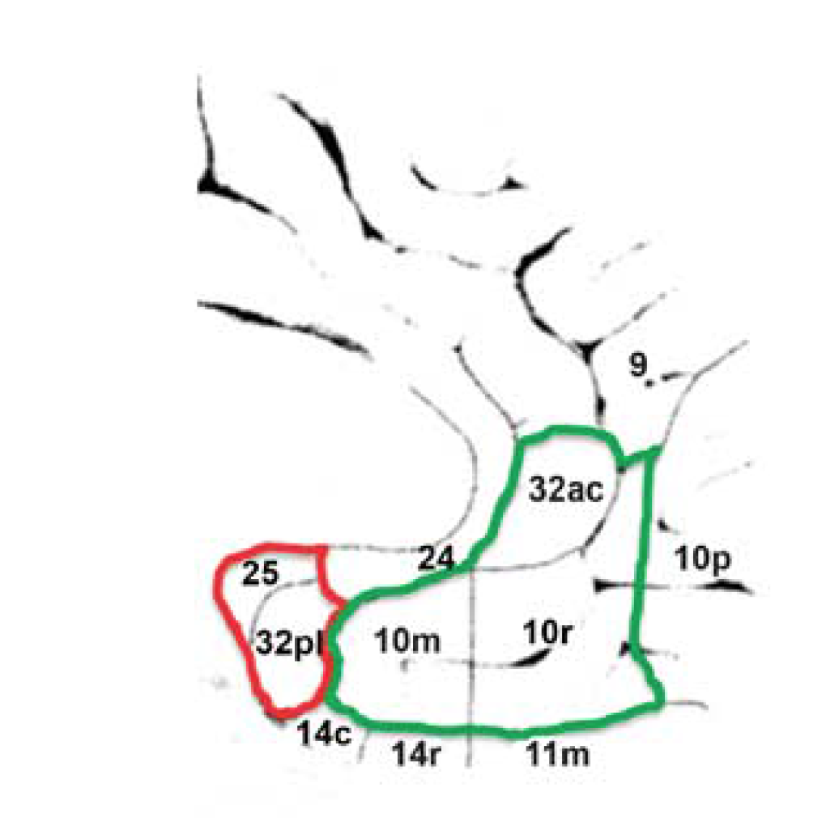
Myers-Schulz and Koenigs, 2012

Slide 19
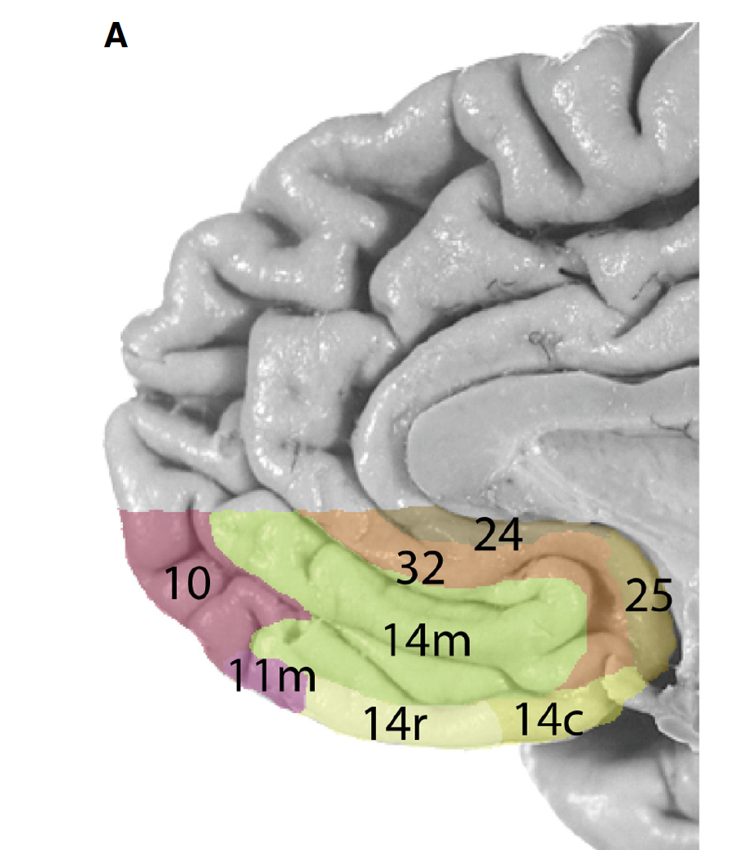
Two New Parcellations based on the Cellular Architecture
Mackey and M. Petrides, 2014
Ongur, et al. 2003

Slide 20
How much these areas work independently?
Myers-Schulz and Koenigs, 2012

Slide 21
How much these areas work independently?
Myers-Schulz and Koenigs, 2012

Slide 22
How much these areas work independently?
Myers-Schulz and Koenigs, 2012

Slide 23
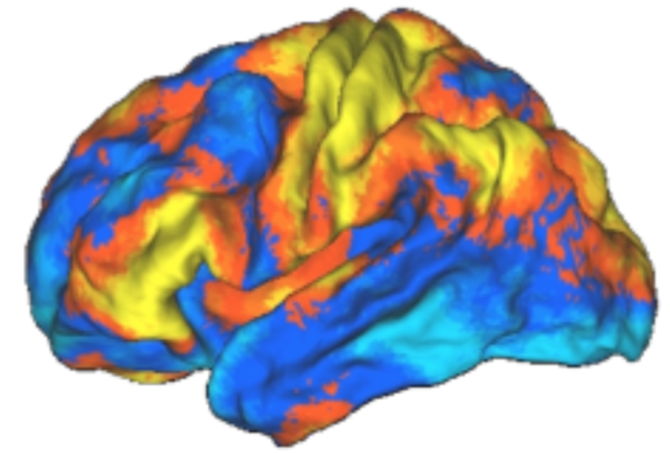
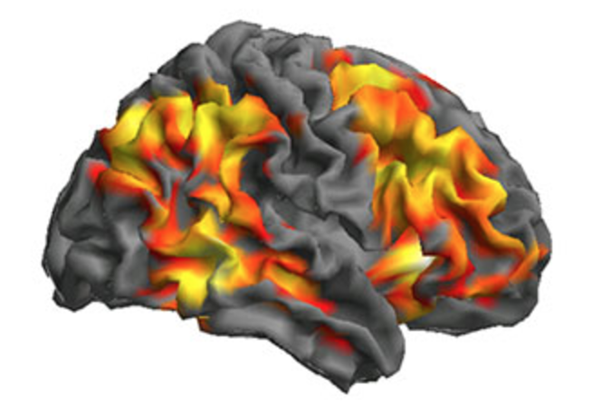
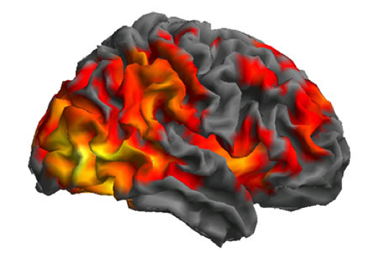
Mechanistic Question:
Do we have differential connectivity between Amygdala and VMPFC in correlation with different positive and negative affective symptoms?
Individualized Voxel-wise
connectivity map with Amygdala
Y=a*Positive + b*Negative
Notes:
Other questions:
Trauma and Structural Changes
Interaction terms?

Slide 24
Fronto Amygdala Connectivity What about DLPFC!

Slide 26
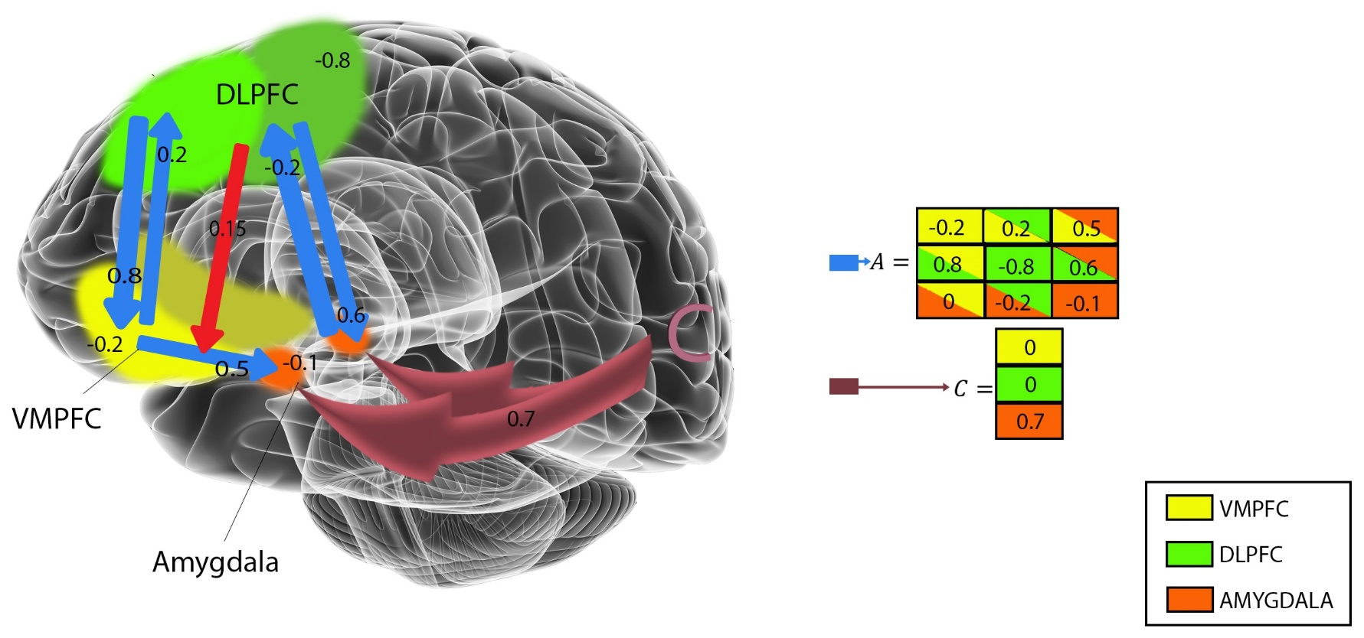
Activations

Slide 28
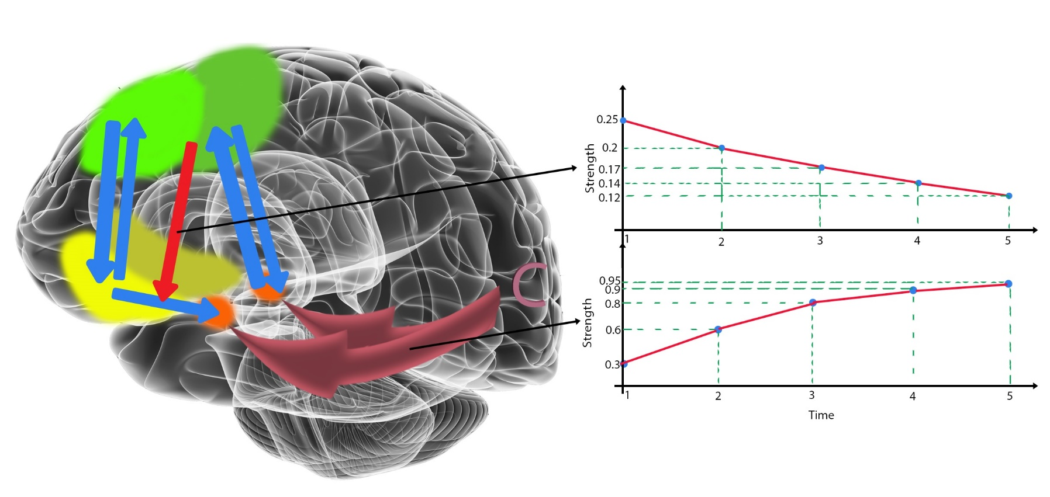
Time Variable DCM

Slide 29
Fronto Amygdala Connectivity (FAC) as a Biomarker
1. What are the "cognitive processes of interest" that the FAC represents?
2. What are the "Psychopathologies" that change FAC?
3. What are the diagnostic/prognostic/diagnostic values of FAC in certain psychopathologies?

Slide 30
What have we learned today?

